Slide 1
EFFECTIVENESS OF DRUG EVALUATION
Here is where your presentation begins

Slide 2
MINI Project By MSc Applied Statistics [II year SEM III]
TEAM-
1.Shravantika (1058-22-508-003)
2.Ashritha (1058-22-508-008)
3.Prasanna (1058-22-508-013)
4.Ajay (1058-22-508-018)
5.Hiranmai (1058-22-508-023)

Slide 3
Table of Content:
Slide No. | Content
4 | objective, Introduction
5 | Data Set
6 -13 | Data Cleaning
14 - 19 | Data Visualization
20 - 23 | Model Prediction
24 | Conclusion

Slide 4
Objective:
The goal is to analyze a dataset on drugs and understand how factors like ease of use and patient satisfaction relate to drug effectiveness.
Introduction:
The effectiveness of drug evaluation plays a pivotal role in shaping healthcare practices and patient well-being.
Assessing how drugs perform in real-world scenarios involves a multidimensional analysis that considers factors such as efficacy, ease of use, and patient satisfaction.
This evaluation process is instrumental in guiding healthcare professionals, researchers, and regulatory bodies in making informed decisions regarding the adoption and continued use of pharmaceutical interventions.

Slide 5
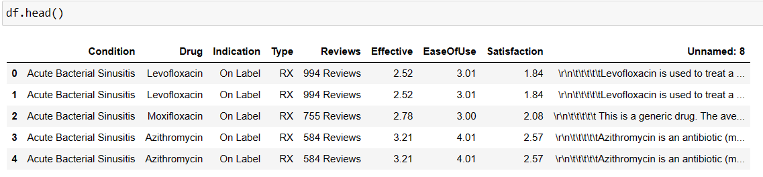

Data set:
Data Source: www.kaggle.com
-The above image represents dataset on drug effectiveness consisting of 2219 x 9 values drawn from KAGGLE website.
-HEAD( ) function displays the first 5 rows of the dataset.
-SHAPE( ) function describes the dimensions of our dataset.

Slide 6
DATA CLEANING

Slide 7
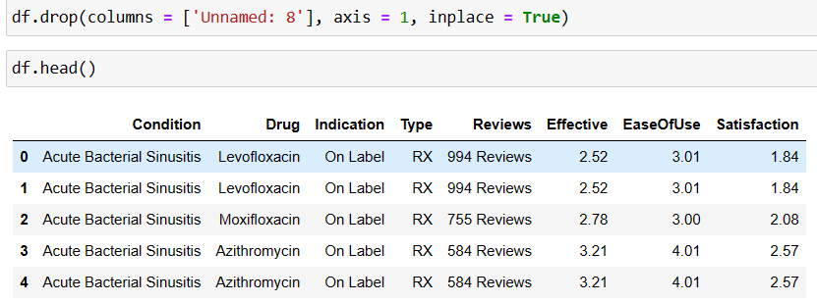
-Removes inaccurate, incorrect and irrelevant data from the dataset.
-Since ‘Unnamed:8’ is not required, using drop( ) function, the column has been dropped.

Slide 8
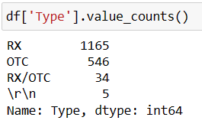
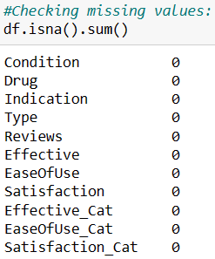
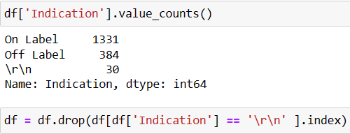
-Here unknown values ‘\r\n’ are eliminated from the dataset using drop( ) function. -isna( ).sum( ) function describes the aggregation of null values.

Slide 9
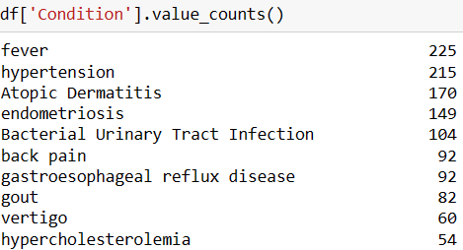
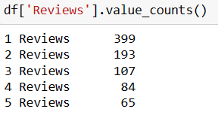
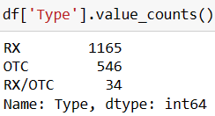
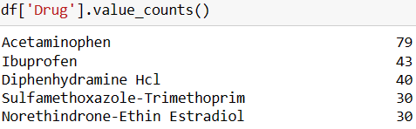

- value_count( ) function marks out the frequency of the data values,repeated in the dataset.

Slide 10
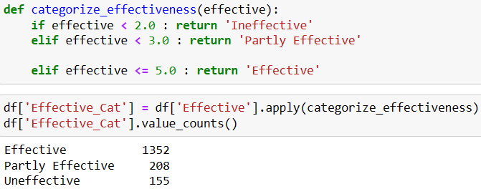
Categorizing the values
-The data values which varies between 1-5 is categorised into 3 parts as ineffective, partly effective and effective.

Slide 11
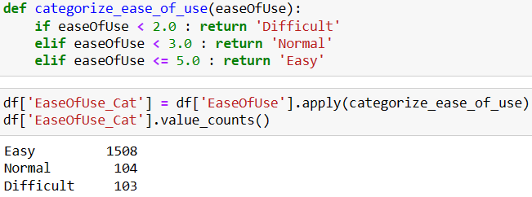
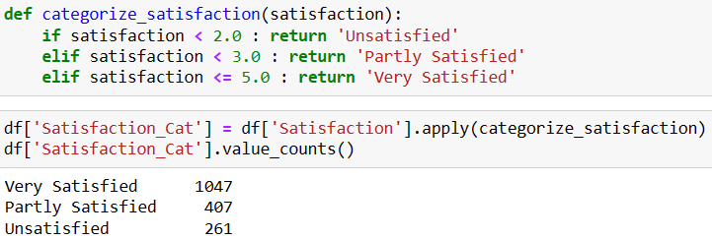
Similarly,

Slide 12
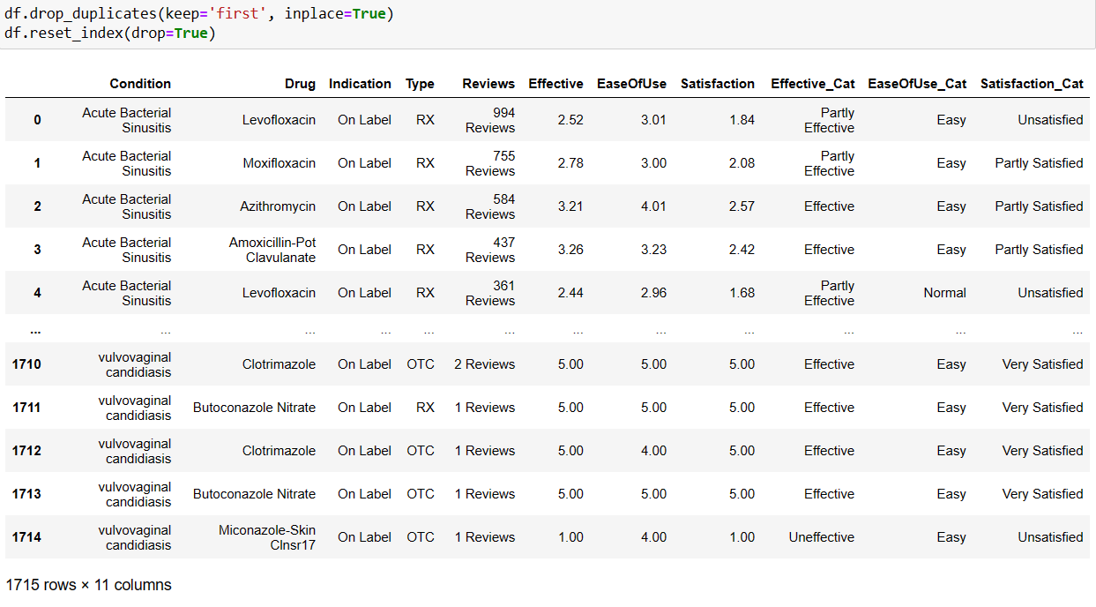
Dataset including categorical variables:

Slide 13
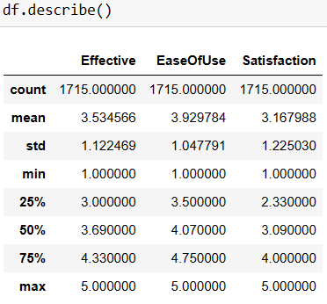
-Since the index values varies as some of the rows are eliminated thus we rest the index.
-describe( ) function states the total no.of values in the dataset which are 1715, its mean approximately 3 for all the 3 columns, standard deviation, range which is between 1-5,Q1 ie..,25% of the dataset, median and Q3 ie..,75% of data values.

Slide 14
DATA VISUALIZATION

Slide 15
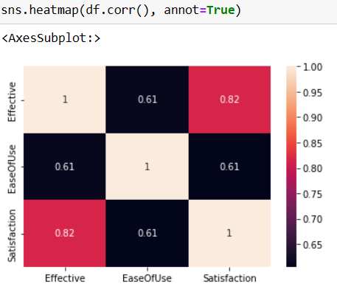
Using seaborn and matplotlib packages, we visualize the data.
Here the Heatmap represents the correlation between satisfaction, ease of use and effectiveness which generally depends upon how dark the color is and in the below diagram it is said that the attributes are positively correlated.

Slide 16
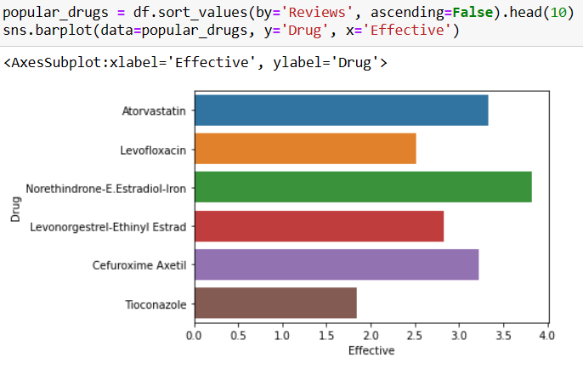
The values in dataset are sorted based on ‘Reviews’ in descending order representing top 6 drugs.
-Estradiol-Iron( hormones problems as PCODs) is the most preferred drug.
-Tioconazole(anti-fungal medicine) is preferred less comparatively among 6 drugs.

Slide 17
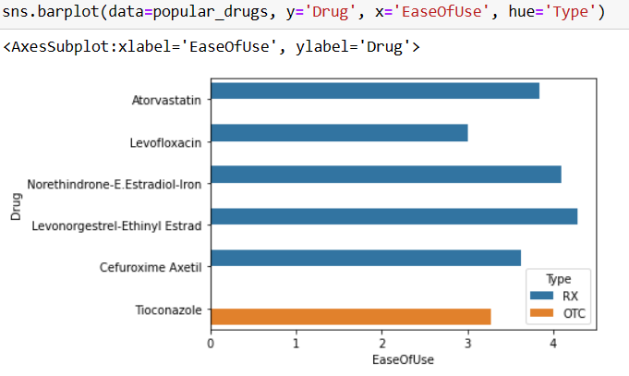
Here the most preferred drugs are represented graphically using barplot based on who had prescribed the patient.
-Atorvastatin(Lowers cholesterol & prevents heart diseases), Levofloxacin(anti-biotic),Estradiol-Iron, Levonorgestral(birth control), Cefuroxime Axetil(anti-biotic) are prescribed by Doctors while Tioconazole is prescribed by pharmacist or chemist.

Slide 18
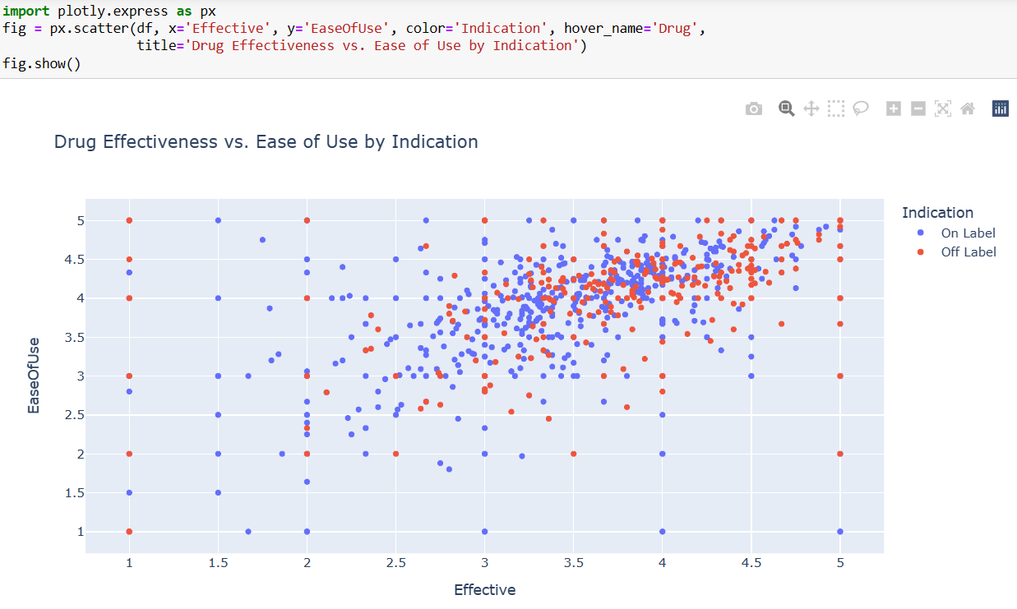
The scatter plot shows that ‘Effectiveness’ and ‘Ease of use’ are positively correlated.

Slide 19
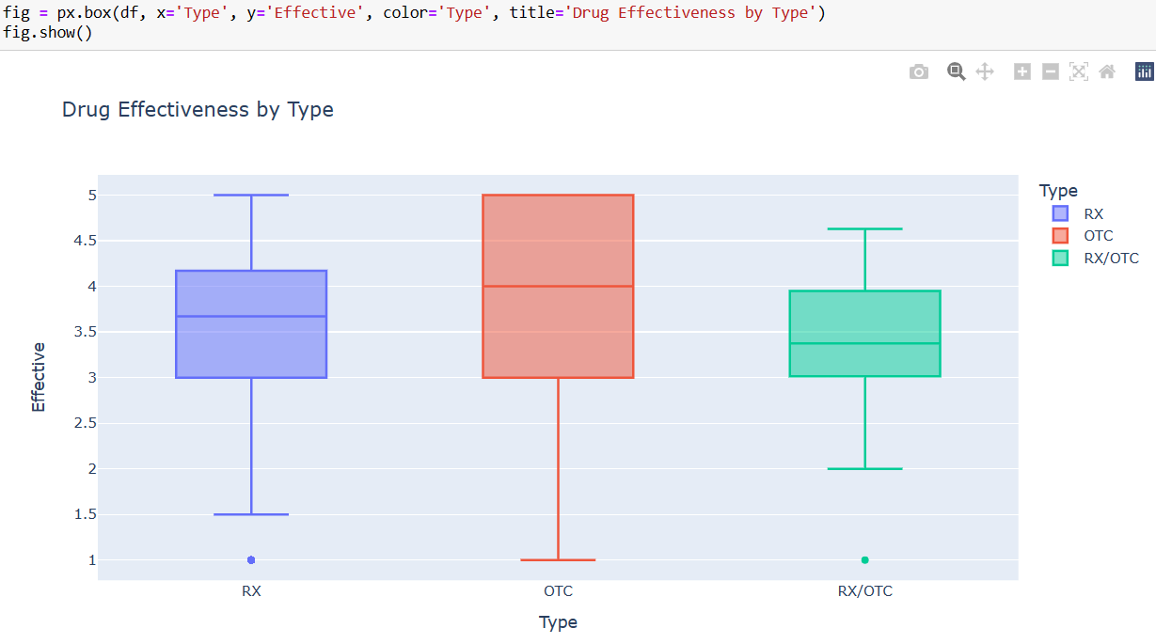
The boxplot represents the outliers.
-Here RX and RX/OTC show outliers as it is said that the drugs prescribed by both doctors and drugs which can be either prescribed by doctors or chemist have effective range such that least drugs show 1 as its effective level.

Slide 20
MODEL PREDICTION

Slide 21
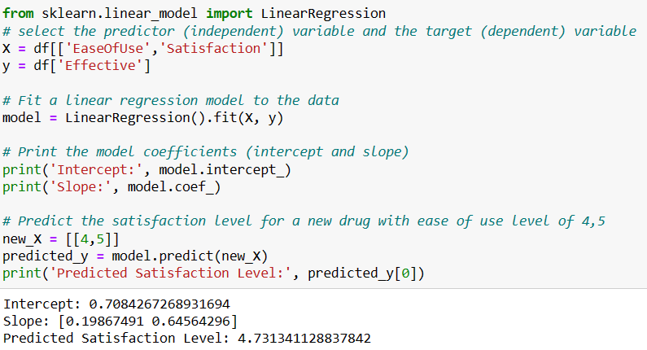
This is a Python code snippet that uses the scikit-learn library to perform linear regression on a dataset. The code snippet first selects the predictor (independent) variable and the target (dependent) variable from the dataset. Then, it fits a linear regression model to the data using the LinearRegression() function. The model coefficients (intercept and slope) are printed using the intercept_ and coef_ attributes of the model object. Finally, the code snippet predicts the satisfaction level for a new drug with ease of use level of 4,5 using the predict() method of the model object.

Slide 22
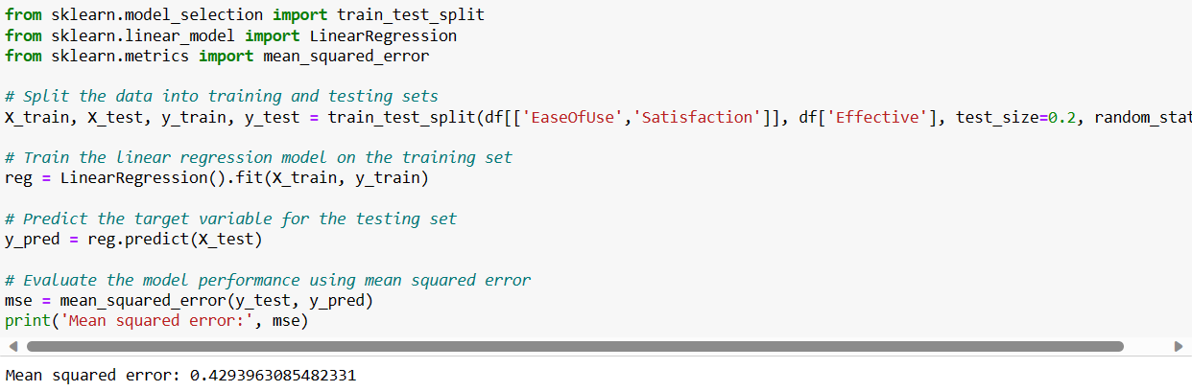
This is a Python code block. It trains a linear regression model on the given dataset and evaluates the model performance using mean squared error. The code first splits the data into training and testing sets using train_test_split function from sklearn.model_selection. Then it trains the linear regression model on the training set using LinearRegression class from sklearn.linear_model. After that, it predicts the target variable for the testing set using predict method of the trained model. Finally, it evaluates the model performance using mean squared error calculated using mean_squared_error function from sklearn.metrics. The output of the code is the mean squared error.

Slide 23
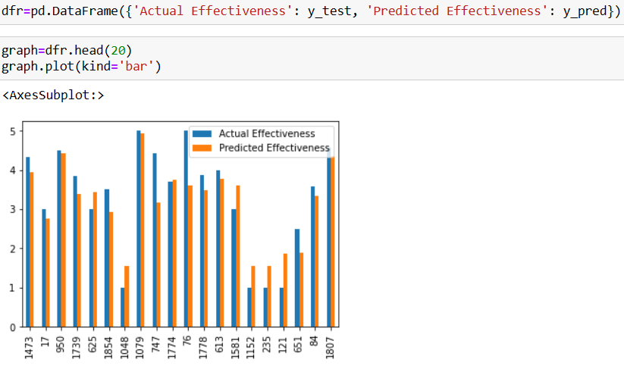
This code creates a DataFrame dfr with two columns, ‘Actual Effectiveness’ and ‘Predicted
Effectiveness’, and then selects the first 20 rows of the DataFrame using the head() method. The
plot() method is then called on the graph object with the kind parameter set to 'bar' to create a bar
graph. Finally, the show() method is called on the plt object to display the graph.
​

Slide 24
Conclusion:
Therefore, the predicted model using linear regression is accurate as both the actual and predicted values are a match.

Slide 25
THANKYOU

